Slide 1
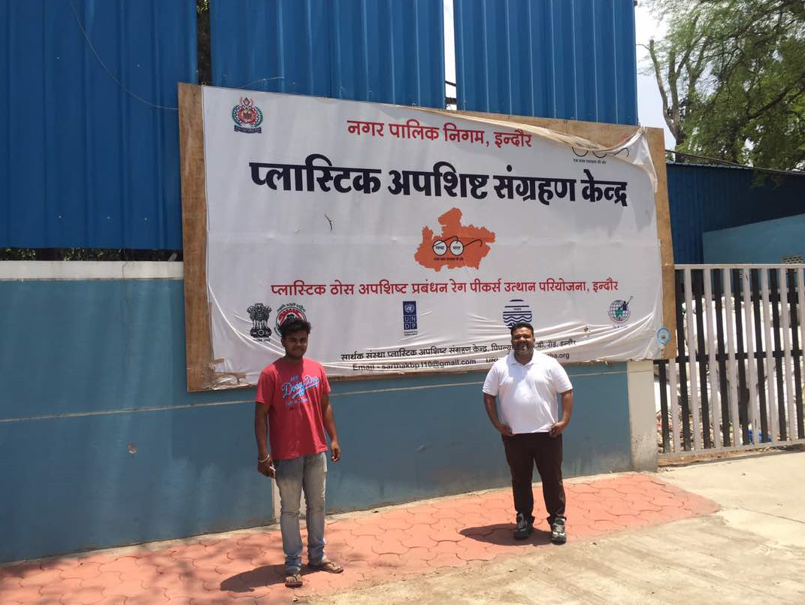
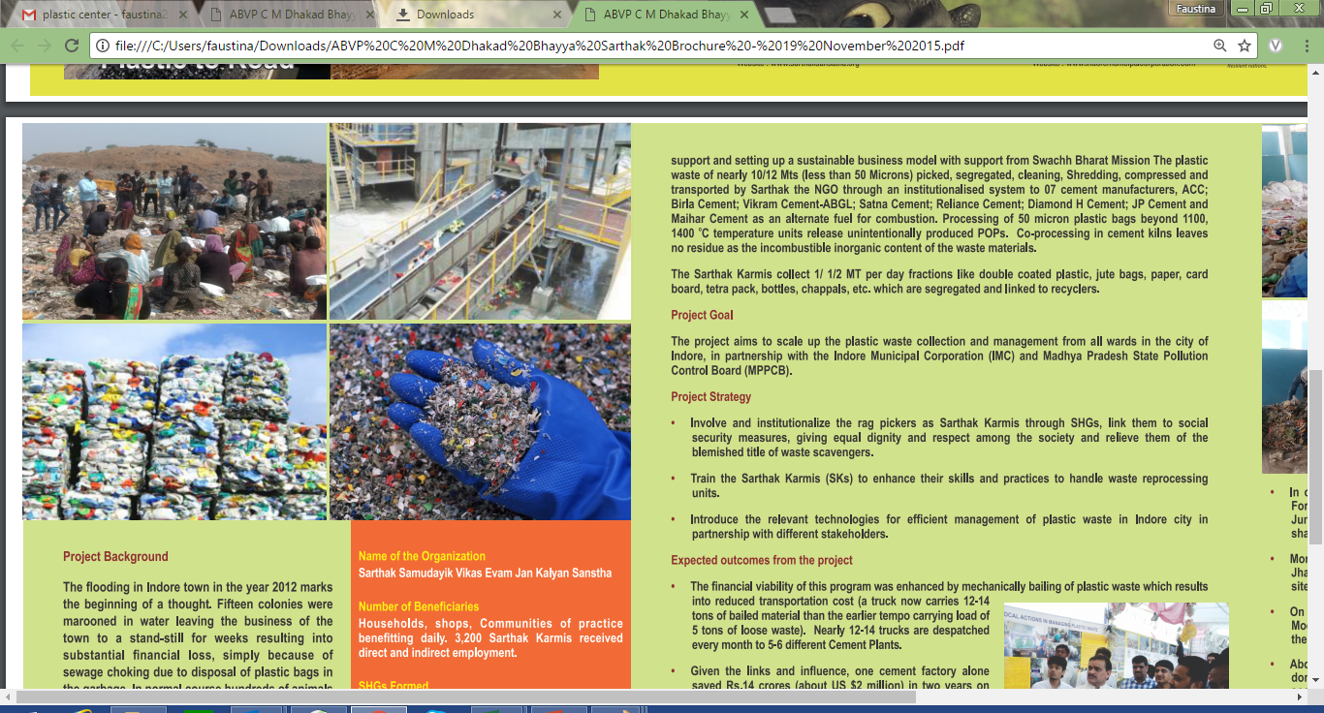
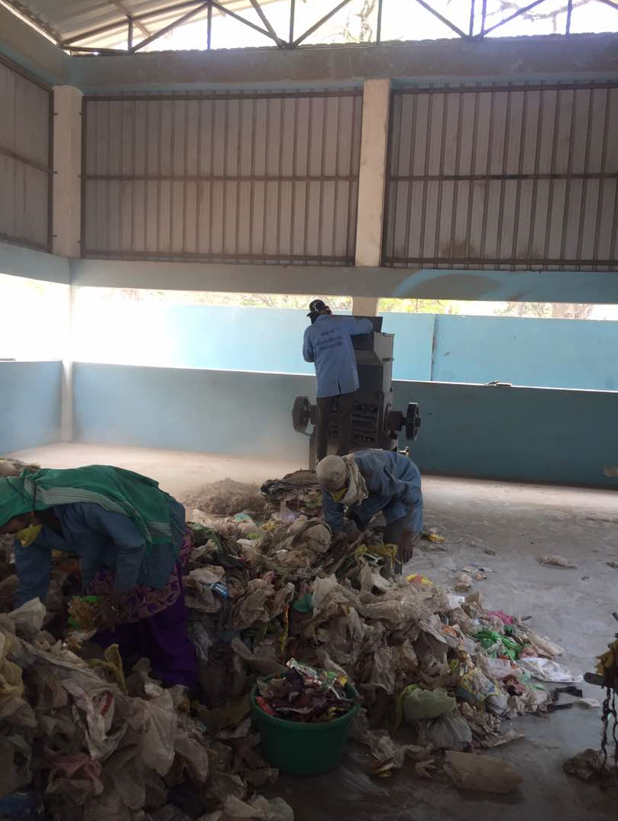
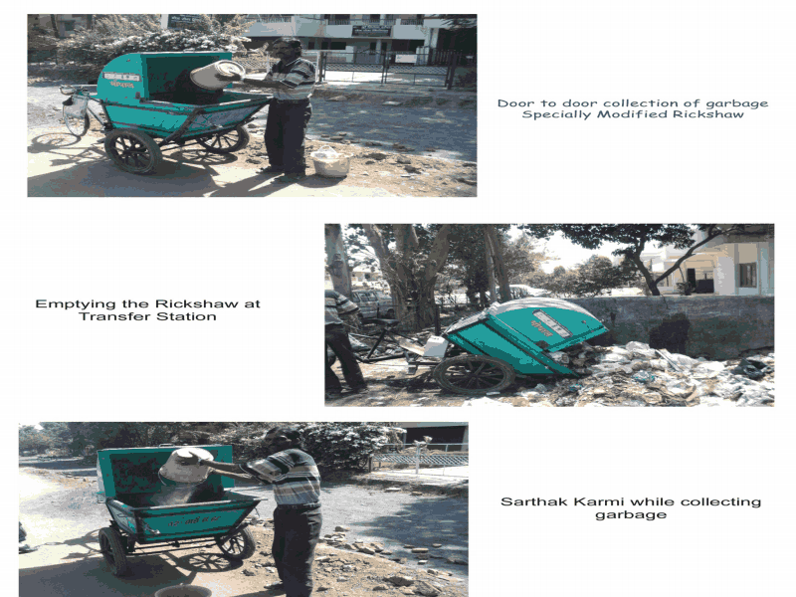
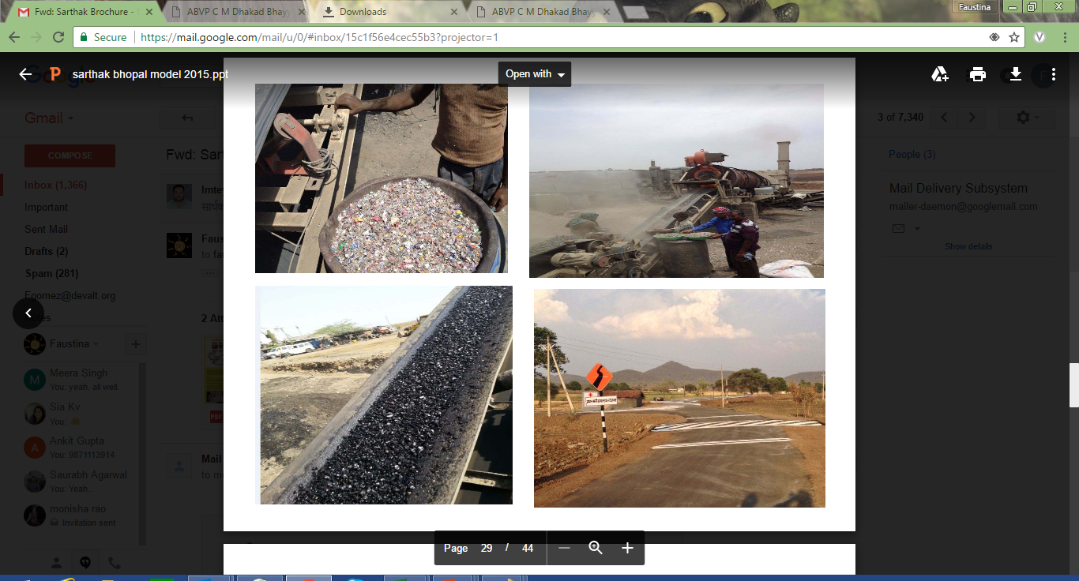
Plastic Waste Collection Centre- Madhya Pradesh Model
About the Centre
Unit Economics
First of the kind Plastic Waste Collection Centre set up in Indore (2011), Bhopal (2008) and Dewas (2015) on a PPP model
Each center covers 25 wards/villages (3 lakh population) and employs around 50 people (including waste collectors + employees)
Generates a profit of Rs.1000 per day
S.No. | Items | Cost (Rs.)
I | Capital Expenditure
a. | Construction | 4,00,000
b. | Fatka machine | 2,00,000
c. | Shredding Machine | 3,00,000
d. | Bailing Machine | 3,00,000
e. | Tools & Equipment | 50,000
 | Total* | 12,50,000
II | Operational Expenditure
a. | Salary (5 people including machine operators, segregators and unit managers) | 1,00,000
b. | Wages for Ragpickers/Waste Collectors | 6,00,000
c. | Electricity | 30,000
d. | Administration Expenses | 50,000
e. | Marketing & Publicity | 10,000
f. | Local Travel | 20,000
 | Total (A) | 8,10,000
 | Cost recovered through sales of plastic to road development authorities & cement factories (B) | 8,40,000
 | Profit per month (B-A) | 30,000
 | Profit Per Day | 1,000
Process of Handling Plastic Waste at the Centre
Plastic Waste <100 microns
Collection Centre
Shredding Machine
Road Construction
Supply of Waste by Rag -pickers
Main Collection Centre
Collection Centre
Fatka Machine
Bailing Machine
Cement Factories
Plastic Waste >100 microns
*Capital Expenditure borne by the Municipal corporation(s)

Slide 2
Benefits at the Triple Bottom Line
Social
Creation of employment opportunities for nearly 1700 Safaii Mitras rag pickers Every Day
Mainstreaming of Rag pickers/Waste Collectors into the formal system of waste collection and segregation (Regular income of Rs. 175-Rs. 200 per day has emerged out of the project for each rag picker/waste collector)
Providing them the Dignity & Respect and Identity (through identity cards by the MC).
Economic
Reduced Transportation Costs (owing to bailing of waste Vs transporting loose waste)
Huge savings for Cement factories (One factory served by the Indore centre saved Rs. 14 crores in 2 years on account of fuel cost through the alternate use of plastic fuel)
Environmental
Reduction in carbon emission from burning of plastic waste instead of coal
Recycling of plastics and avoid the litter in places
Prevention of choking of sewage lines ensuring health and hygiene and avoiding flooding during rainy seasons

